Slide 1


CODIL : The Competitive Coding Platform
Welcome to CODIL, the platform designed to elevate your competitive programming journey.
Presented by
Soumya ranjan sahoo

Slide 2


contents
Introduction to CODIL
Objective of CODIL
Process and Methodology
Technology Used
Project Screenshot
Future Scope
Conclusion

Slide 3



Introduction to CODIL
What is Competitive Coding?
It's a mind sport. Programmers solve problems quickly. It enhances critical thinking.
Why Does It Matter?
It sharpens problem-solving. It builds efficient coding habits. It's great for interviews.

Slide 4





Objective of CODIL
Solve questions
Key Skills
Master algorithms, data structures, and mathematics. These are core to success.
Solve complex problems . It's a mental marathon for coders.
Popular Contests
Join LeetCode, ICPC, Google Code Jam. Test your abilities globally.

Slide 5
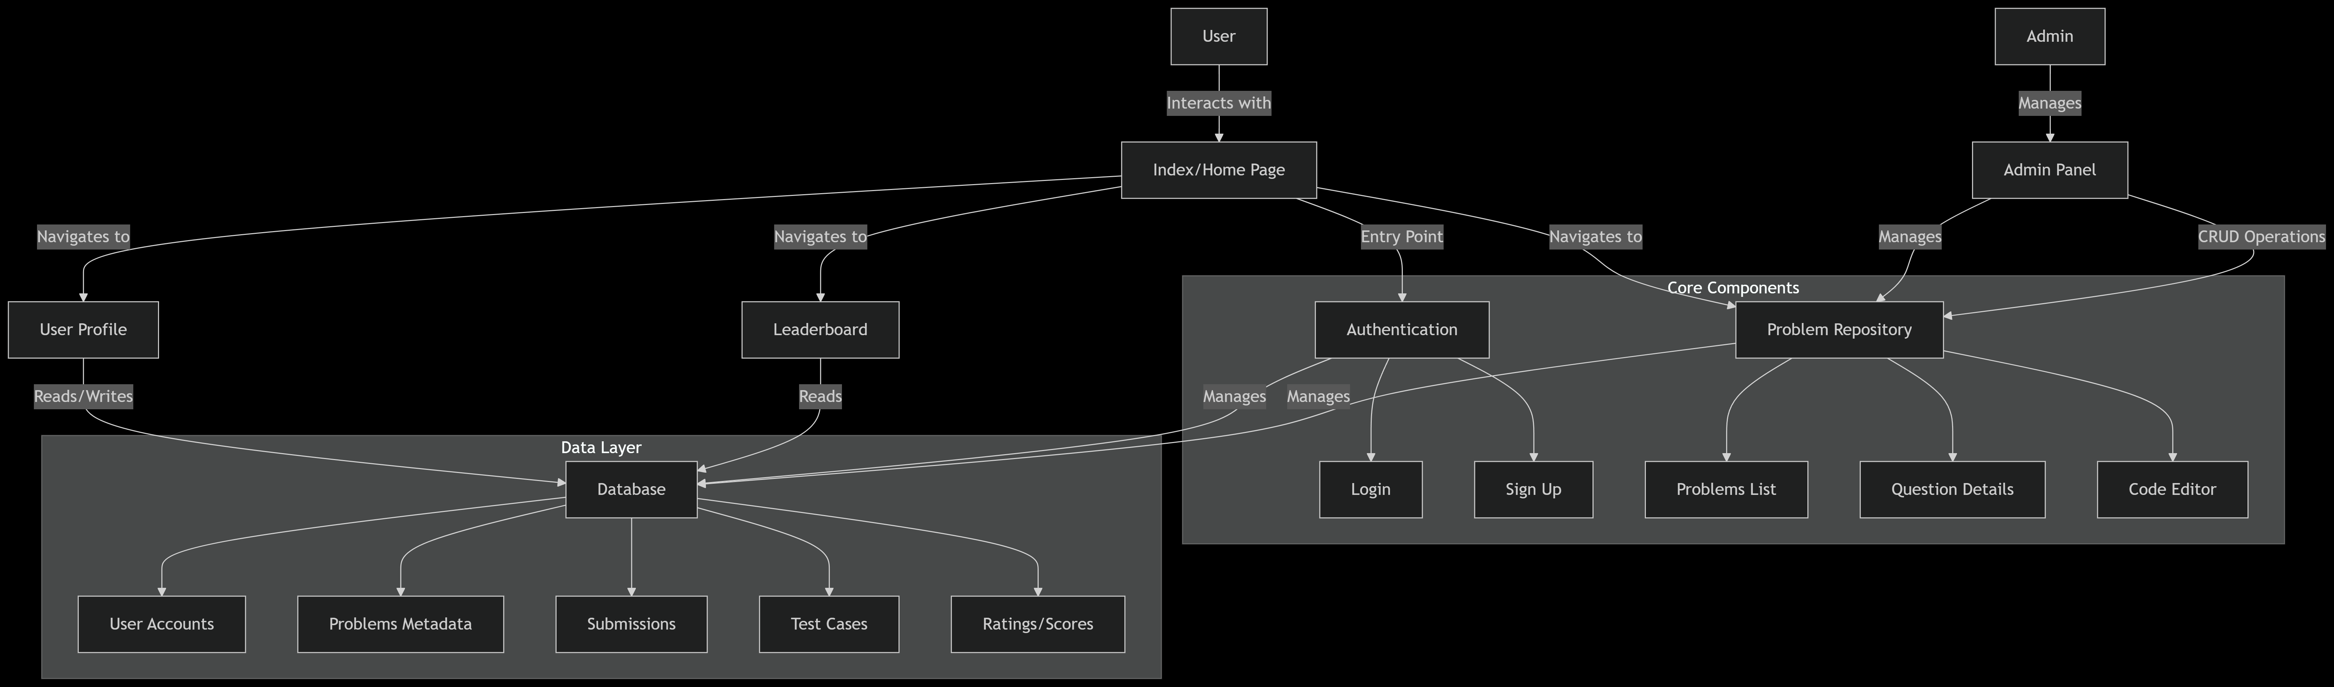

Slide 6





Process or Methodology
User Submits Code
Code is uploaded to our platform. It's the first step to evaluation.
System Compiles
Our backend compiles your submitted code. We ensure proper execution.
Tests Run Automatically
Automated test cases validate correctness. Performance is also measured.
Results Displayed
Receive instant feedback. See your score and areas for improvement.

Slide 7

Technology Used
Frontend: HTML, CSS, JS
Serverside: PHP
Database: XAMPP
We use standard web technologies. HTML for structure, CSS for styling. JavaScript provides dynamic interactions.
PHP handles server-side logic efficiently. It processes requests and manages data.
XAMPP provides a local server environment. It manages our database for user data. Data is securely stored and retrieved.

Slide 8
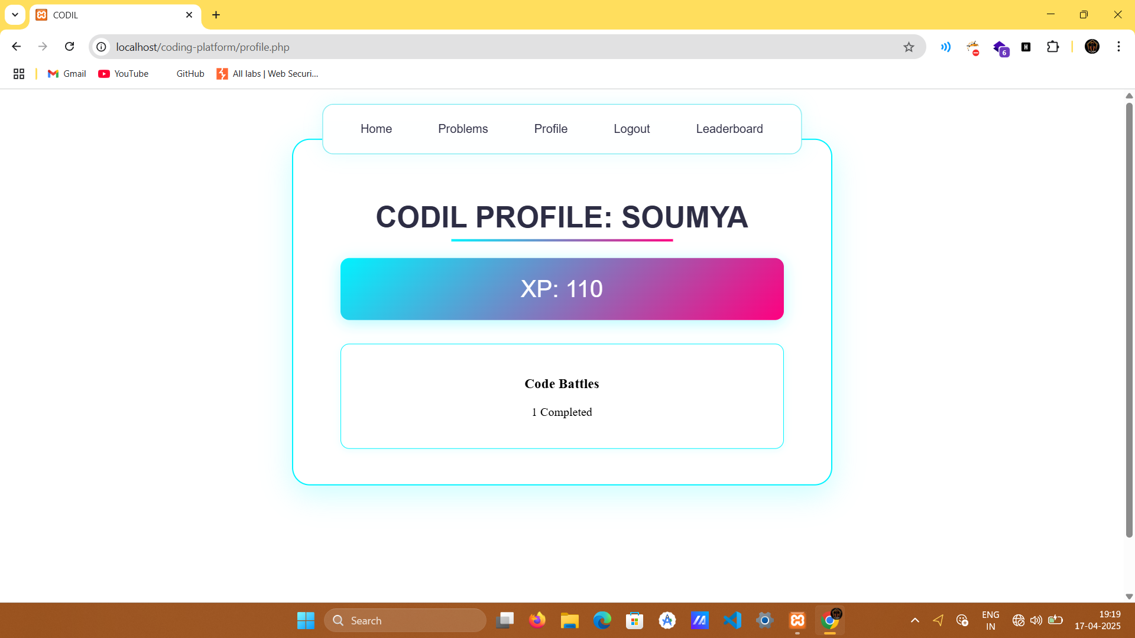
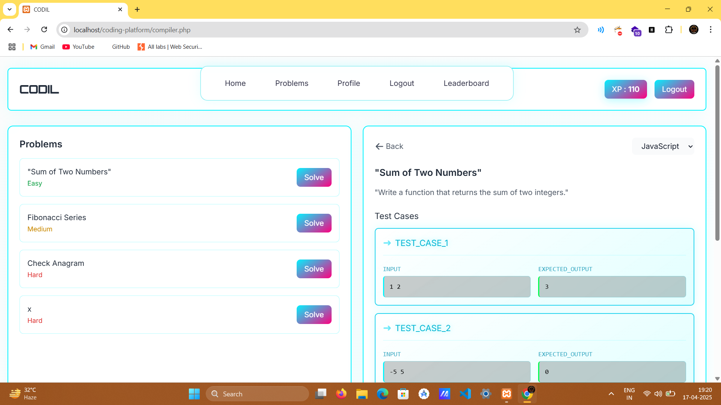
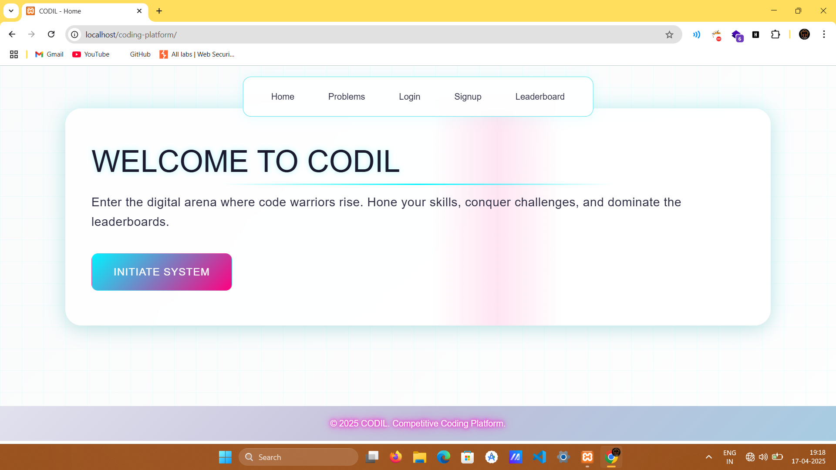
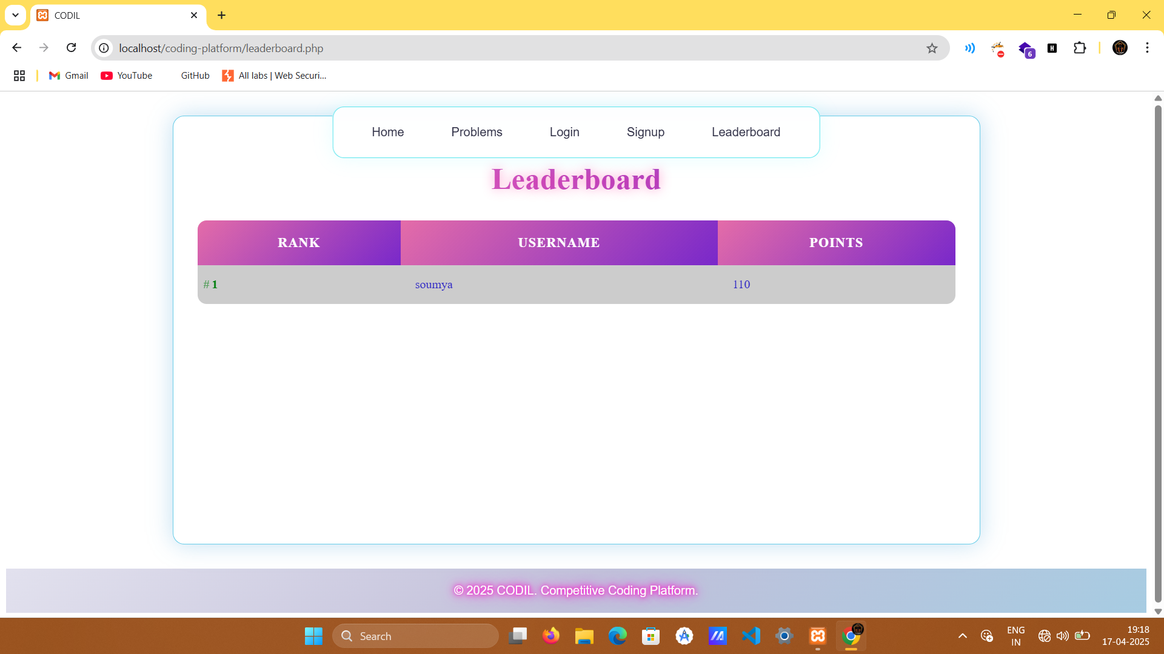
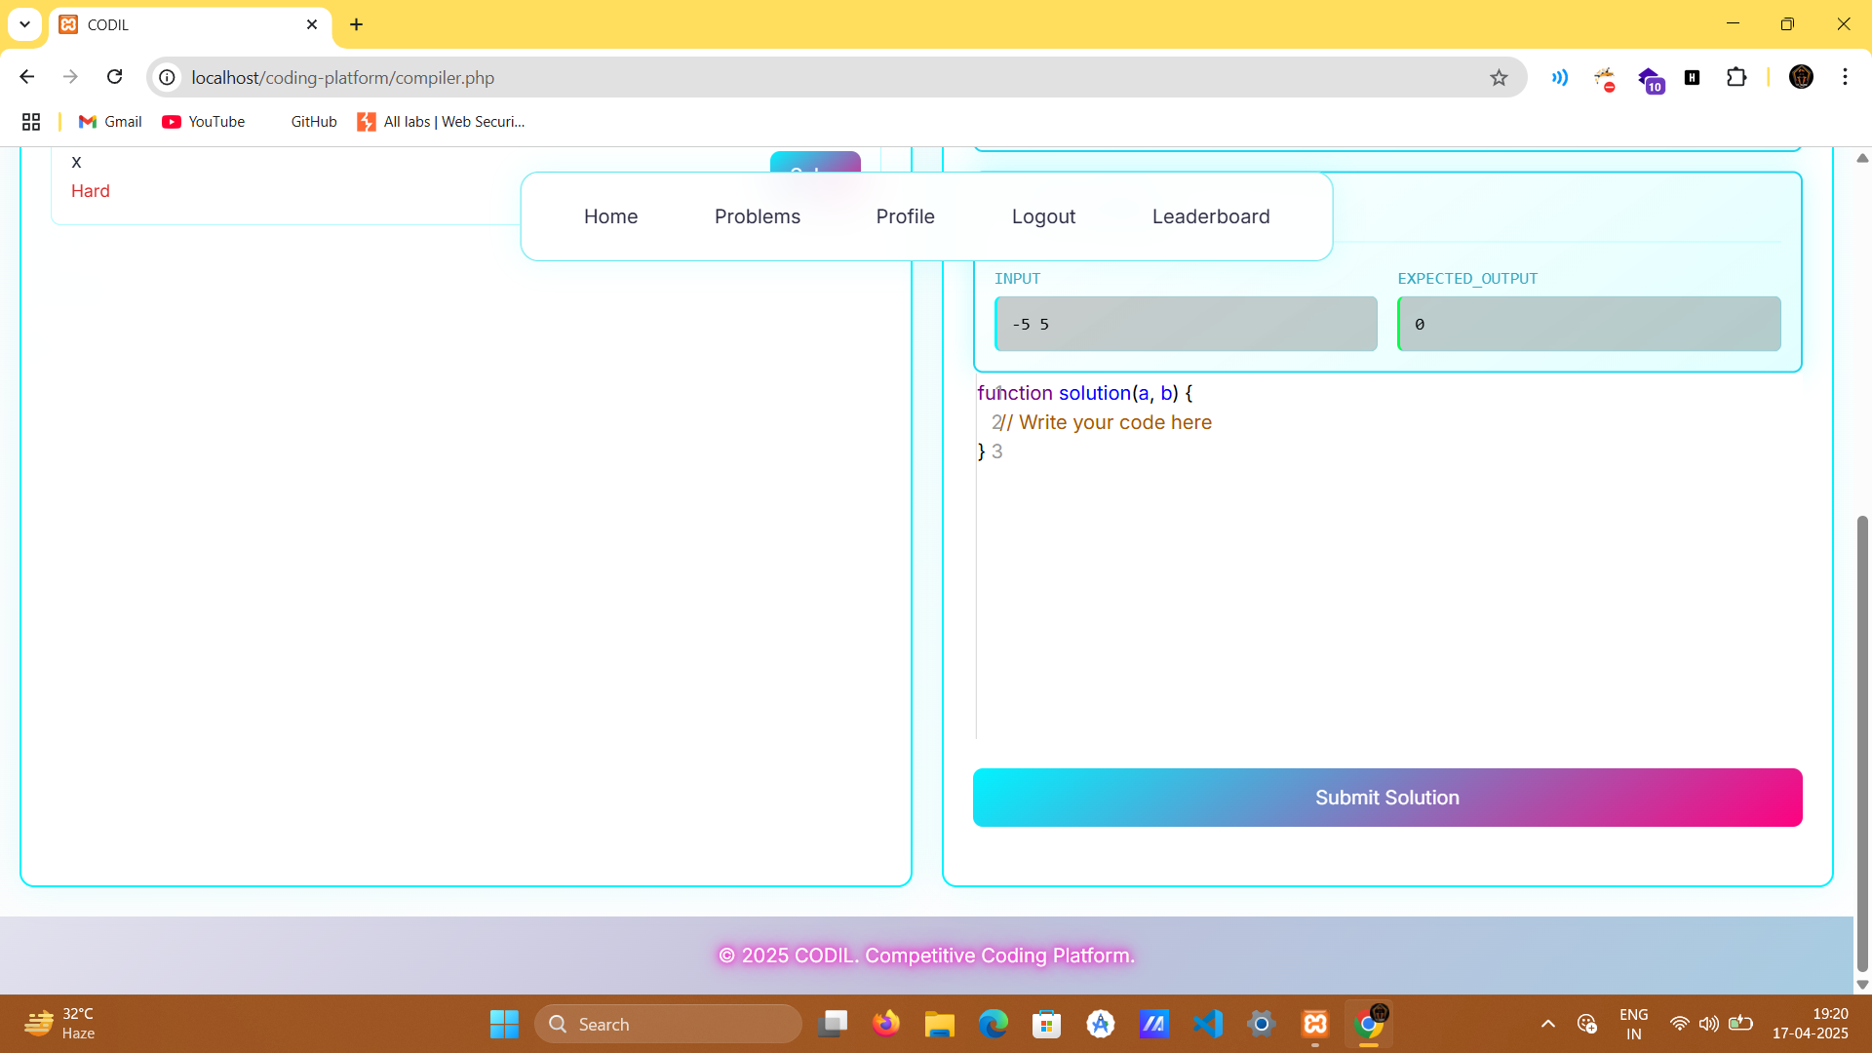
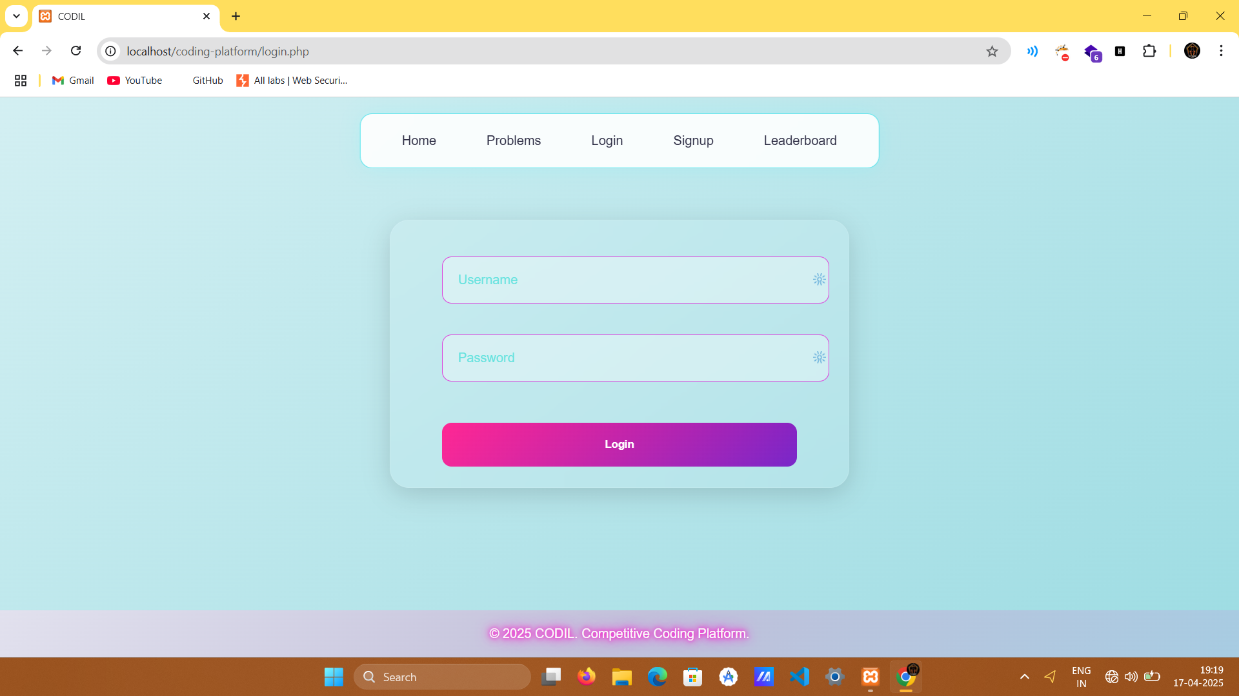
Project Screenshots

Slide 9


Future Scope
AI-Powered Feedback
Implement AI for personalized hints. Improve problem-solving guidance.
Expanded Language Support
Add more programming languages. Cater to a wider user base.
Gamified Learning Paths
Introduce leaderboards and achievements. Make learning more engaging.
Mobile Application
Develop a native mobile app. Enable coding on the go.

Slide 10




Conclusion
CODIL offers a robust platform. It empowers competitive coders. Achieve your full potential. Join our growing community.
Skill Advancement
Continuously improve your algorithmic thinking.
Community Engagement
Connect with a global network of coders.
Career Readiness
Prepare for technical interviews and job opportunities.

Slide 11


Questions? Please feel free to ask. We are here to help.

